Slide 1
Smart automatic plant watering system……

Slide 2
introduction
The Project is based upon Closed Loop Control System. In closed loop control system, the feedback loop is there which continuously provide the data and with the help of that data the system configures its output. We can automatically water the plants when we are going on vacation or don’t, we have to bother my neighbors, Sometimes the neighbors do too much of watering and the plants end up dying anyway. There are timer-based devices available in India which waters the soil on set interval. They do not sense the soil moisture and the ambient temperature to know if the soil actually needs watering or not. The purpose is to regulate water and optimize the water flow so that plants are not starved of water. This is particularly useful during summer seasons when water is scarce. During monsoon and winter seasons, the water flow can be optimized depending on the requirement, thus saving precious water

Slide 3

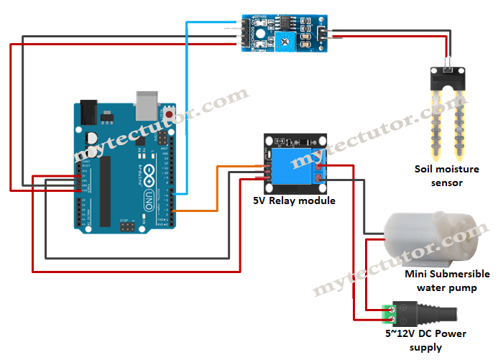
CIRCUIT DIAGRAM

Slide 4
problem
Water is a very precious resource and must be properly utilized. Agriculture is one of those areas which consume a lot of water. Irrigation is a time consuming process and must be done on a timely basis.
The aim of the article is to develop an auto irrigation system which measures the moisture of the soil and automatically turns on or off the water supply system.
The project requires very less human involvement once installed. The circuit is based on PIC microcontroller and also a soil moisture sensor.

Slide 5
Components used
Soil moisture sensor
Buzzer
Peristaltic pump
L298N H-bridge motor shield
HW battery with clips
Jumper wires

Slide 6
WORKING
The soil moisture sensor is inserted in the soil. Depending on the quality of the sensor, it must be inserted near the roots of the plant. The soil moisture sensor measures the conductivity of the soil.
Wet soil will be more conductive than dry soil. The soil moisture sensor module has a comparator in it.
The voltage from the prongs and the predefined voltage are compared and the output of the comparator is high only when the soil condition is dry.
This output from the soil moisture sensor is given to the analogue input pin (Pin 2 – RA0) of the microcontroller. The microcontroller continuously monitors the analogue input pin. When the moisture of the soil reaches the threshold value, the output of the soil moisture sensor is low and the motor is turned off.
The system is also designed to warn when the moisture is very high than the threshold and the soil is too wet, which is dangerous for the plant.

Slide 7
Design and develoPMENT
Requirement gathering components
Right sensor selection
Prototype designing
Working module
Testing and optimization
Itrative improvments
Correct the errors
Finaliztion and deployment

Slide 8
APPLICATION
The circuit can be used to measure the loss of moisture in the soil over time due to evaporation and intake.
Minimizes water waste and improves plant growth.
The circuit is designed to work automatically and hence, there is no need for any human intervention.
The project is intended for small gardens and residential environment. By using advanced soil moisture sensor, the same circuit can be expanded to large agricultural fields.

Slide 9
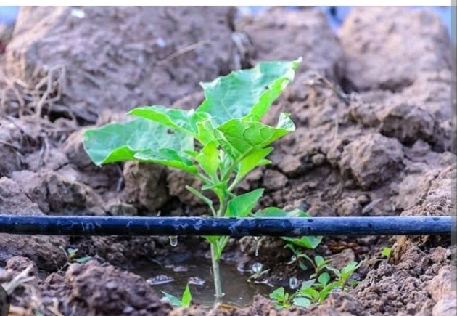
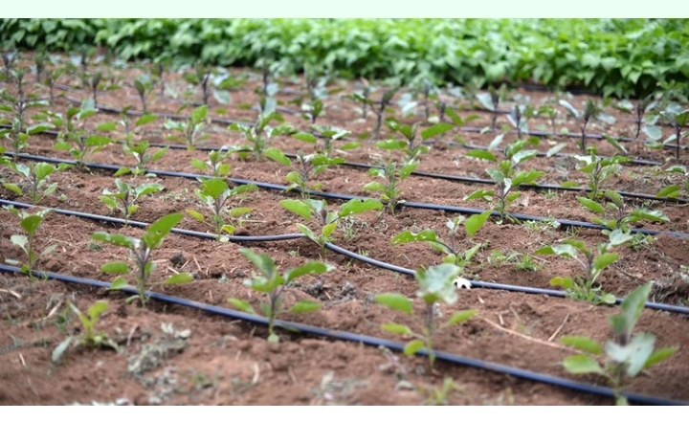
SMART IRRIGATION SYSTEM

Slide 10
CONCLUSION
1 . As the motor would be remotely operable the farmer
can monitor the power supply status of the field and
irrigate the field based on the available power supply.
2 . The soil moisture level would also help the farmer
monitor the health of soils and fertilizers in the field and
thus helping him to increase the yield.

Slide 11
THANK YOU….

